Slide 1
eagle-i
OBI Tutorial ICBO 2011
Notes:
Notes - What is eagle-i
- Application ontology
- why we used OBI
- Usage of instrument
- collaborative effort on Excel
- aligning instrument representation across NIF and eagle-i for data consistency and interoperability
- Mention QTT
- Service representation
- OBI: design pattern
- how we have mapped this in
Focus on if you need to start form scratch OBI is a good place
- it can "easily" be extended according to your needs
- ensure compliance with standards

Slide 2
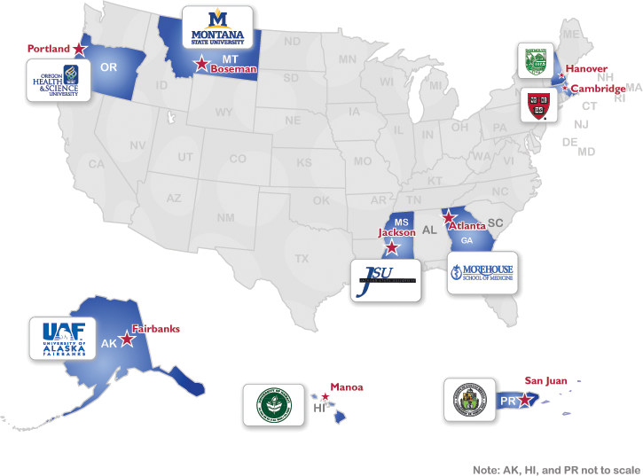


eagle-i
NIH funded 2-year pilot project working to make scientific research resources more visible via a federated network of nine institutional repositories
Helping researchers find invisible
resources
reagents, protocols, techniques, instruments, expertise, organisms, software, training, human studies, biological specimens, etc.
Adding meaningful semantic relationships between resources
Making this data available using ontology-driven approach to research resource annotation and discovery
Reducing time-consuming and expensive duplication of resources
www.eagle-i/home
c o n s o r t i u m

Slide 3
eagle-i ontology challenges
Build an application ontology
to annotate real data about a large set of resources
to drive UI and logic of curation and search applications
Following best practices for ontology development
Comply to OBO foundry principles
Reuse existing ontologies
Be aligned with similar efforts (OBI, NIF, VIVO,..)
c o n s o r t i u m

Slide 4
eagle-i ontology
Modular structure to address the challenges
Direct imports vs MIREOT
Currently XXXX classes
in the core module
c o n s o r t i u m

Slide 5
eagle-i ontology
Application specific modules
Used to create application specific annotation
Preferred labels
restrictions on domain and range
Annotation to exclude upper level classes form displaying
c o n s o r t i u m

Slide 6
Why OBI?
Ontology that follows OBO Foundry principles (easy to integrate and import stuff , same upper onto, and designing principles)
be interoperable as much as possible with other efforts (reuse an ontology that will be used in other efforts)
Have support form the community of devs
Don’t’ reinvent the wheel
c o n s o r t i u m

Slide 7
Use cases
A set of terms and property imported
Techniques,
Two use cases:
Instruments
Services
c o n s o r t i u m

Slide 8
Use case: Instrument
Goals
Reuse classes had already been defined in OBI
Use the same OBI design pattern for eagle-i instrument classes
Define equivalent classes based on device functions
Eg: measurement device
Equivalent to:
device
and (has_function some 'measure function')
Align instrument representation with NIF
Contribute back enriching OBI devices
c o n s o r t i u m

Slide 9
Instrument implementation
1) Align eagle-I and NIF instrument with OBI devices
2) MIREOT the device classes already present OBI (eg. DNA sequencer, centrifuge)
3) Generate request for new terms using Quick Term Template (QTT)
4) MIREOT back from OBI the new instrument classes into eagle-i
c o n s o r t i u m
Notes:
Maybe I will have just the slides with the figures

Slide 10
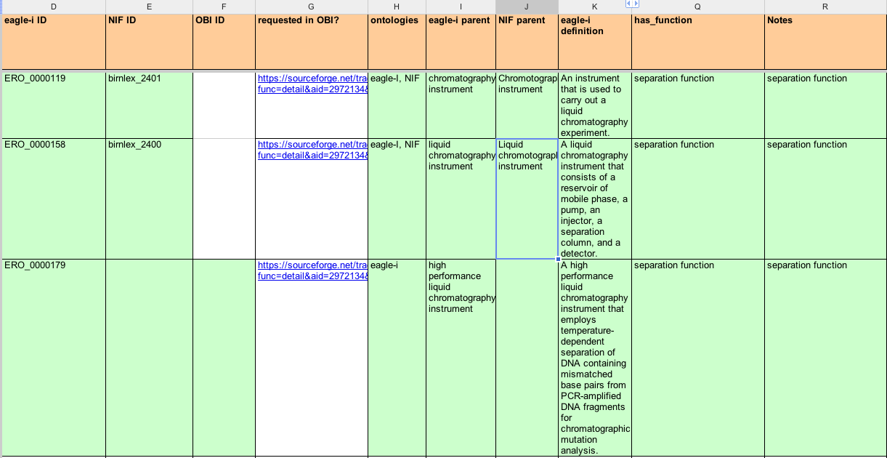
Instrument implementation
Align eagle-i instruments with OBI devices and NIF instruments
2) MIREOT the device classes already present OBI (eg. DNA sequencer, centrifuge)
c o n s o r t i u m
Notes:
Here say that we actually created our own instrument calss because

Slide 11
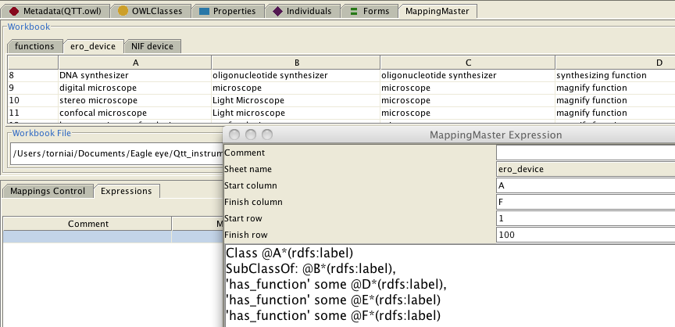
Instrument implementation: QTT
Generate new terms to be implemented in OBI by using Quick Term Template (QTT)
c o n s o r t i u m
Notes:
Here I may want to need

Slide 12
Instrument implementation
Screenshot of Protégé or the glossary with the inferred hierarchy of measurement instrument
c o n s o r t i u m
Notes:
Maybe I will have just the slides with the figures

Slide 13
Instrument implementation: Advantages
Advantages in using already defined devices in OBI
Definitions and metadata already available and vetted by the community
Advantages to align representations (EI/NIF/OBI)
Same URI facilitate data integration and interoperability
Advantage of reusing an effective design pattern
Functional hierarchy for eagle-I instrument
Contribution to OBI development
c o n s o r t i u m
Notes:
Maybe I will have just the slides with the figures

Slide 14
Use case: Service
Goals:
Come up with a shared and agreed with representation of services
Align with NIF representation of services
c o n s o r t i u m
Notes:
Maybe I will have just the slides with the figures

Slide 15
Service: implementation
1) NIF and eagle-i requirements:
Collect service information (metadata about services)
Services are typically offered by core laboratories, which perform some planned for a customer.
Have a common representation of the high level services categories
Have service hierarchy that make sense for the eagle-i app purpose (identify services availability at institutions)
c o n s o r t i u m
Notes:
Maybe I will have just the slides with the figures

Slide 16
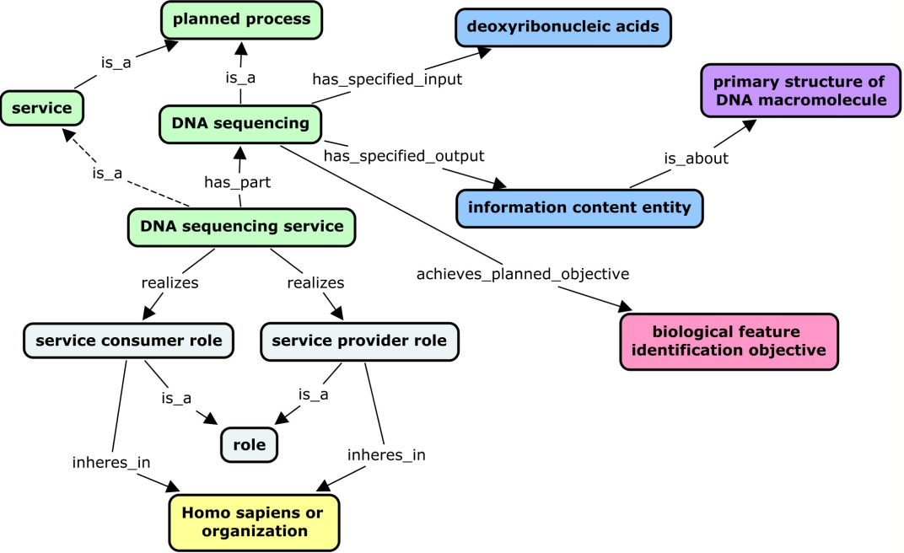
Service: design pattern
Participated in OBI workshop identifying the following
c o n s o r t i u m
Notes:
Services are typically offered by core laboratories, which perform some planned process (for example, an assay or a material production) for a customer. Like planned processes, services are also linked to entities such as protocols, instruments, specimens, reagents, and objectives. However, key features that distinguish services from the planned processes they perform are the additional processes entailed in a service (order placement, billing, etc.). In addition, services necessarily have service providers and service consumers as participants. To capture these distinctions and allow query using these search facets, a design pattern was used in which a service has_part some planned process and realizes some ‘service consumer role’ and ‘service provider role’ which inheres_in a person or organization.

Slide 17
Service: hierarchy
Service hierarchy defined according to process input and output
c o n s o r t i u m

Slide 18
Service: advantages
1) Advantages to align representations (EI/NIF/OBI)
Same URI facilitate data integration and interoperability
2) Identified a design pattern for service that the community can reuse
3) Identified additional requirement for OBI (and reference ontology in general)
- shortcut relations
- community views
Note: eagle-I users requirements may want to have a hierarchy based on process type. Still we can resuse URI and have a different asserted hierarchy
c o n s o r t i u m
Notes:
because sometimes you want complexity and sometime you don’t but you want to go things right

Slide 19
Summary
We had to build application ontology
- we didn’t want to start form scratch
- we wanted to be interoperable with other efforts and follow standard practices for ontology development
OBI was the perfect place for:
MIREOT terms
Achieve alignment with other community efforts (NIF, VIVO) aiming at describing research resources
Reuse and propose new design patterns
c o n s o r t i u m
Notes:
because sometimes you want complexity and sometime you don’t but you want to go things right

Slide 20
Backup

Slide 21
Service Hierarchy in eagle-i
Hierarchy based on Process (we will still use the same classes)
c o n s o r t i u m
Notes:
Shall we say that we will have a possible different asserted hierarchy in eagle-?Maybe just mention that.

